Slide 1
Chapter 3
Discrete Random Variables
and Their Probability Distributions
1

Slide 2
OBJECTIVES
Discrete Distributions
Bernoulli
Binomial

Slide 3
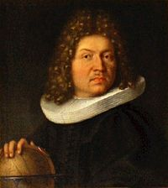
Bernoulli Distribution
Assumptions:
Each trial has two possible outcomes: success and failure.
The trials are independent. The outcome of one trial has no influence over the outcome of another trial.
On each trial, the probability of success is p and the probability of failure is 1-p where p∈[0,1] is the success parameter of the process.
Jacob Bernoulli
(Swiss Mathematician)

Slide 4
Bernoulli Distribution
Mean = p
Variance = p(1-p)

Slide 5
The Binomial Distribution
1. The experiment consists of a sequence of n smaller experiments called trials,
where n is fixed in advance of the experiment.
2. Each trial can result in one of the same two possible outcomes (dichotomous
trials), which we generically denote by success (S) and failure (F).
3. The trials are independent, so that the outcome on any particular trial does not
influence the outcome on any other trial.
4. The probability of success P(S) is constant from trial to trial; we denote this
probability by p.

Slide 6


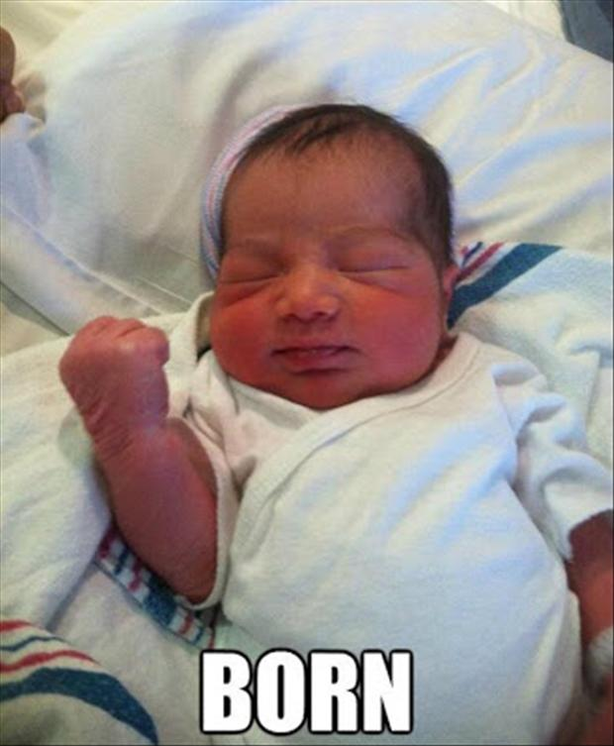
Examples of Binomial Experiment
Consider each of the next n vehicles undergoing
an emissions test, and let S denote a vehicle that
passes the test and F denote one that fails to pass.
Tossing a coin n times, with S if it shows Heads and F if it shows Tails.
The experiment in which the gender (S for female and F for male) is determined for each of the next n children born at a particular hospital.

Slide 7
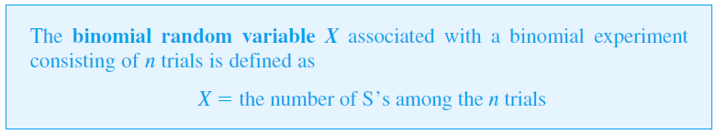
The Binomial RV and Distribution
In most binomial experiments, it is the total number of S’s, rather than knowledge of exactly which trials yielded S’s, that is of interest.
Definition

Slide 8
The Binomial Distribution
Suppose, for example, that n = 3 tosses. SSS SSF SFS SFF FSS FSF FFS FFF
X: # of Heads or Successes.
Then X= 0, 1, 2, 3
Possible values for X in an n-trial experiment are x = 0, 1, 2, . . . , n.
We will often write X ~ Bin(n, p) to indicate that X is a binomial rv based on n trials with success probability p.

Slide 9

The Binomial Distribution pmf
Theorem
Prove that it is a valid pmf.

Slide 10
Example
Each of six randomly selected cola drinkers is given a glass containing cola S and one containing cola F. The glasses are identical in appearance except for a code on the bottom to identify the cola. Suppose there is actually no tendency among cola drinkers to prefer one cola to the other.
a. What is the probability that three people prefer cola S?
b. What is the probability that at least three prefer cola S?
c. What is the probability that at most one prefers cola S?

Slide 11
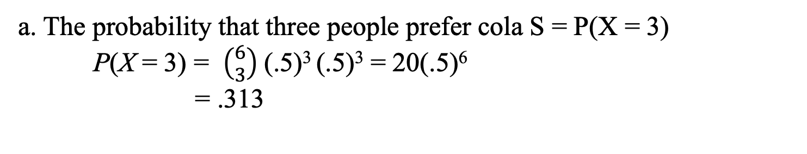
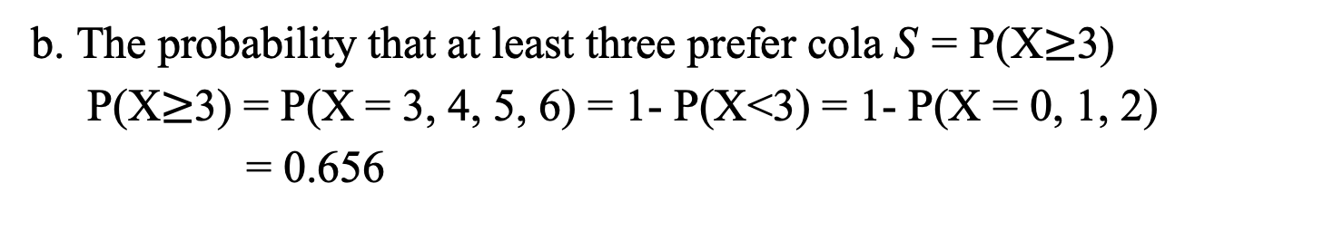
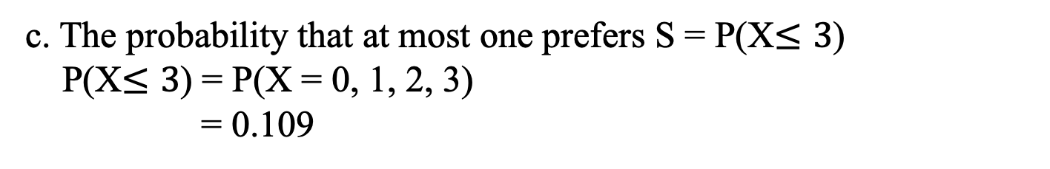
Example (cont’d)
X = the number among the six who prefer S,
n = 6
p = P(a selected individual prefers S) = 0.5
X ~ Bin(n = 6, p = 0.5).
a. The probability that three people prefer cola S = P(X = 3)
P(X = 3) = $\left({6 \atop 3}\right)$(.5)³ (.5)³ = 20(.5)⁶
= .313
b. The probability that at least three prefer cola S = P(X$≥$3)
P(X$≥$3) = P(X = 3, 4, 5, 6) = 1- P(X<3) = 1- P(X = 0, 1, 2)
= 0.656
c. The probability that at most one prefers S = P(X$≤3$)
P(X$≤3$) = P(X = 0, 1, 2, 3)
= 0.109

Slide 12
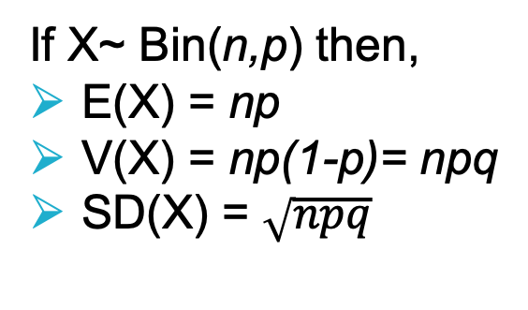
The Mean and Variance of Binomial RV
If X~ Bin(n,p) then,
E(X) = np
V(X) = np(1-p)= npq
SD(X) = $\sqrt{npq}$
Prove the mean and variance of Binomial Distribution.

Slide 13
Example
If 75% of all purchases at a certain store are made with a credit card and X is the number among 10 randomly selected purchases made with a credit card, then X ~ Bin(10, .75). What is the expected number of purchases made with credit card?
E(X) = np = (10)(.75) = 7.5
V(X) = npq = 10(.75)(.25) = 1.875
SD(X) = 1.37.

Slide 14
Example (cont’d)
Again, even though X can take on only integer values, E(X) need not be an integer.
If we perform a large number of independent binomial experiments, each with n = 10 trials and p = .75, then the average number of S’s per experiment will be close to 7.5.

